Slide 1
ETL Project Covid-19
–Zackery Rogers, Jared Nieves

Slide 2


Data Formats Used
This Photo by Unknown Author is licensed under CC BY-SA-NC
This Photo by Unknown Author is licensed under CC BY-SA-NC

Slide 3
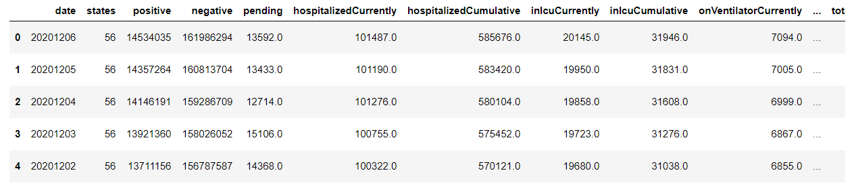
Covid Data USA
Data pulled from Kaggle
CSV formatted
Read into notebook using Pandas

Slide 4
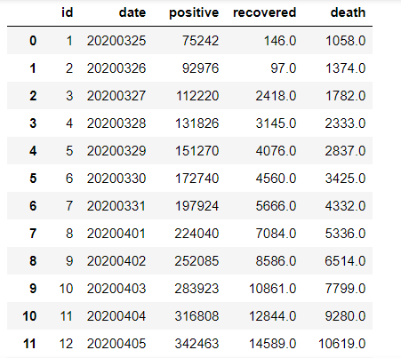
Data Clean Up

Slide 5
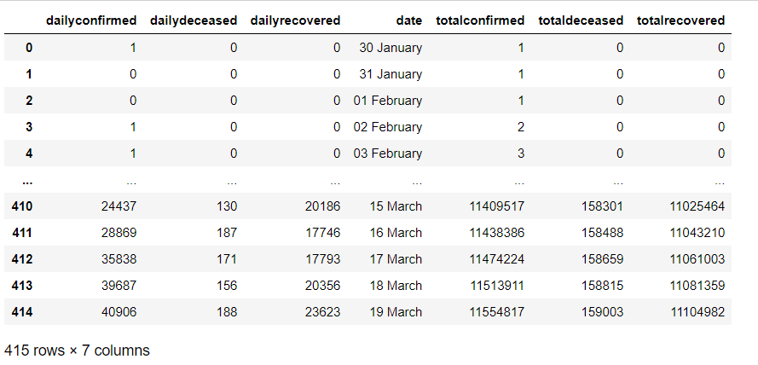
Covid 19 India
JSON Format
Online Data Source

Slide 6
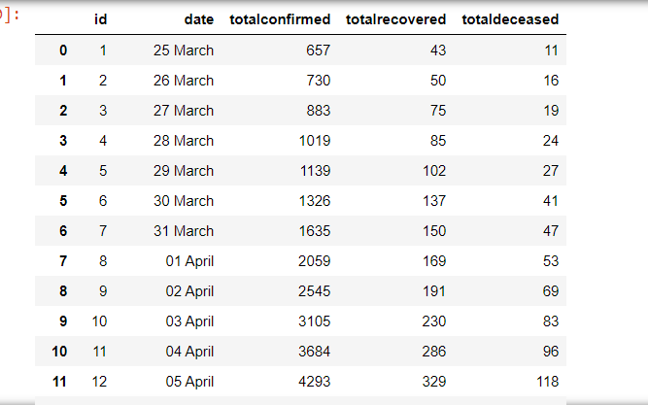
Data Clean Up

Slide 7
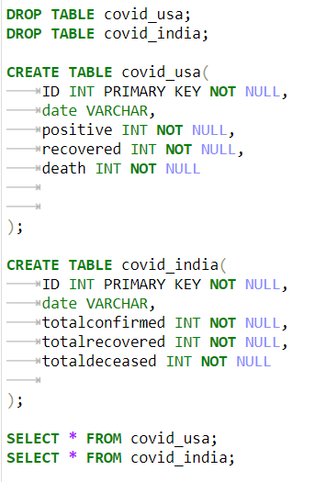
Creating Database In pgAdmin

Slide 8
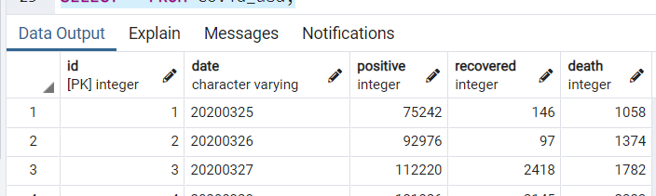
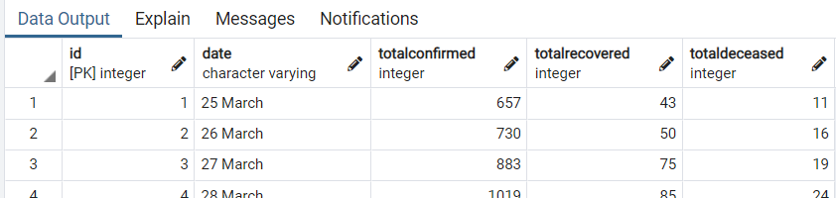
Connecting Data Frame in Notebook to Postgres using Pandas

Slide 9
Thank You!
Sources
Data Sources:
Kaggle - COVID-19 in USA, .csv file
Data.World - Covid19India, .json file

